Slide 1
COSP230 Ch. 5
Lists, Arrays, and Web Browsers

Slide 2
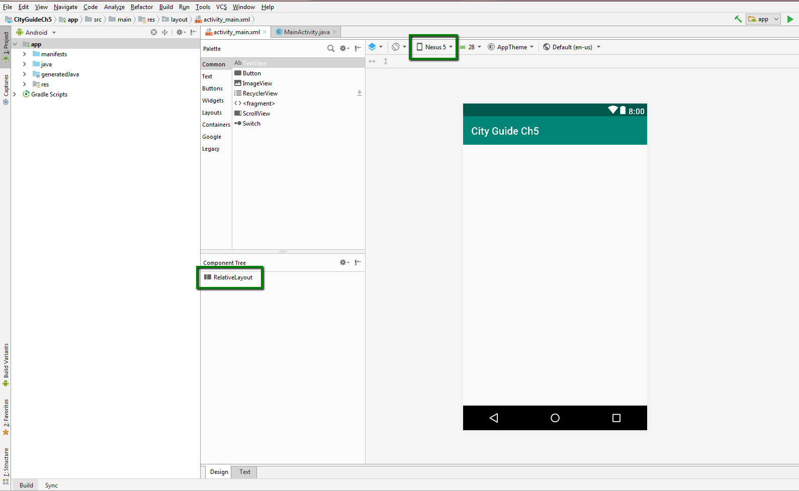
Start of Project (Delete HelloWorld text, select Nexus 5, convert to Relative Layout):

Slide 3
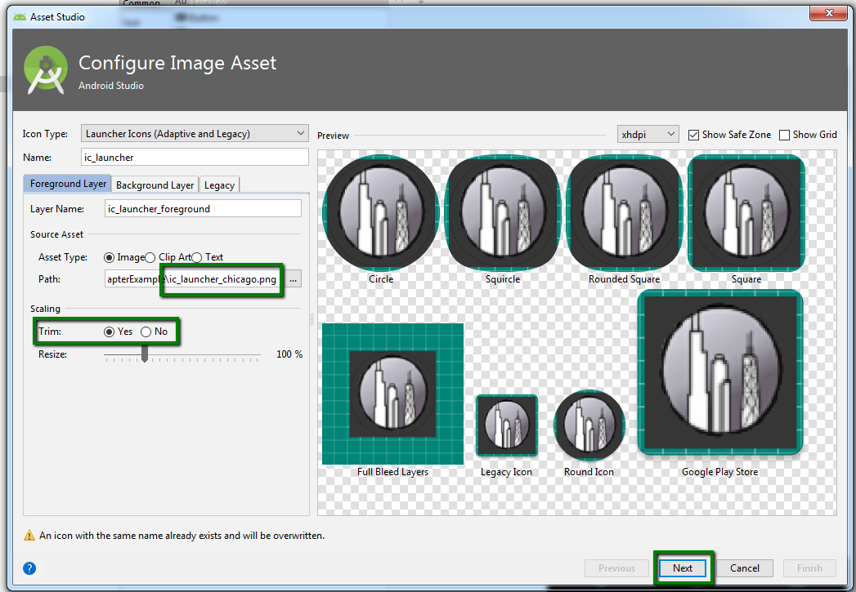
Configure Image Asset window
Download the file ic_launcher_chicago.png to your computer.
In the Android Project view, highlight the activity_main.xml file.
In the menu bar, click the following sequence:
File->New->Image Asset
Click the three dots next to the Path box.
Navigate to the location of the ic_launcher_chicago.png file and select it. Then click OK.
Select Yes in the Trim area.
Click Next.

Slide 4
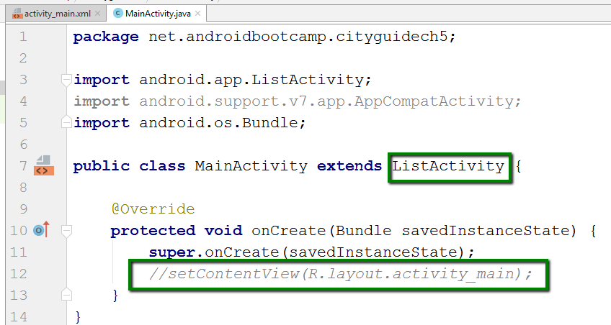
Update MainActivity.java to use List Activity
In MainActivity.java, do the following:
Change AppCompatActivity to ListActivity
You may have to use Alt+Enter to import the proper class
Delete or comment out the call to setContentView

Slide 5
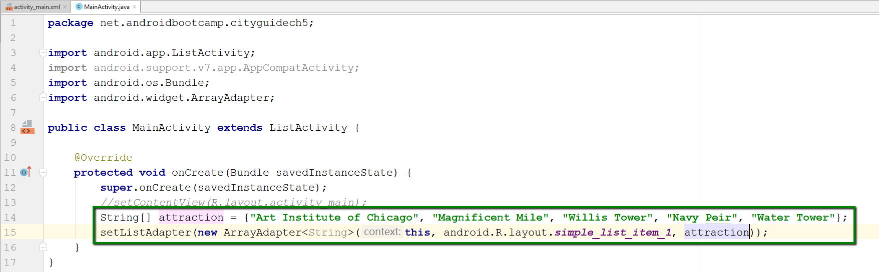
Add an array and a setListAdapter in Java
Array: consists of data type and name.
Can list elements in curly brackets
Index of first element is 0.
setListAdapter: binds elements of an array to a ListView layout, which we will code in Java later.

Slide 6
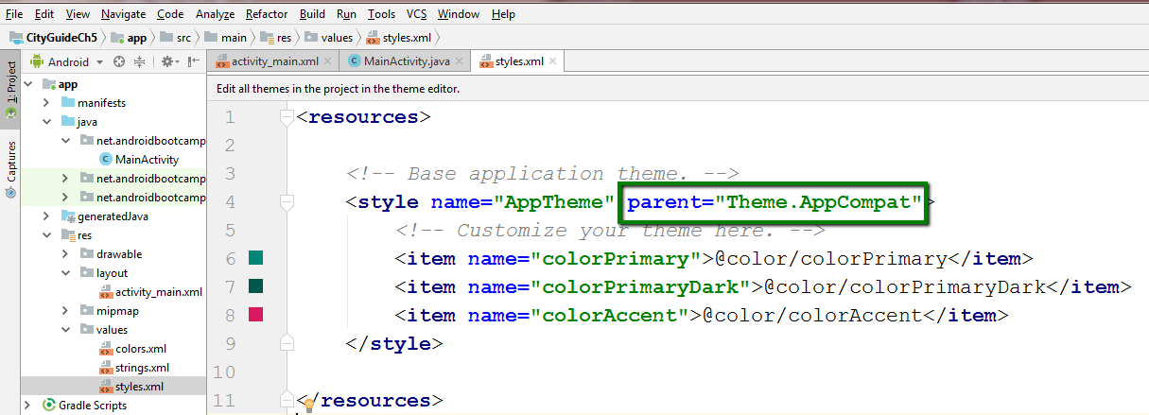
Update styles.xml to use AppCompat
In styles.xml file, change parent to use Theme.AppCompat

Slide 7
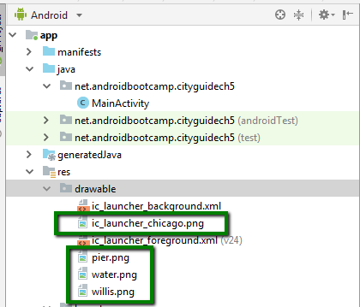
Add graphic files to drawable folder
Download the image files from the Ch 5 Images folder in Files and save to Desktop
Copy and paste the files in the green boxes into the drawable folder

Slide 8
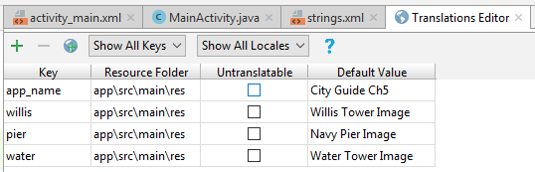
Add keys in Translations Editor
Open the Translations Editor
Add the keys in the table on the right:

Slide 9
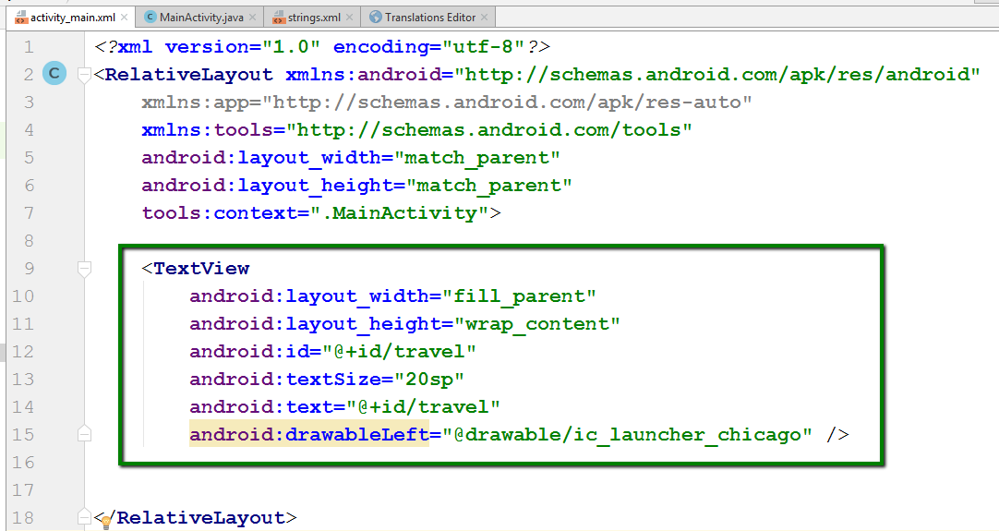
Add XML code to include a TextView widget
Click on activity_main.xml tab
Click on Text tab at bottom of window
Add the code in the green box in the same location as the picture shows.

Slide 10
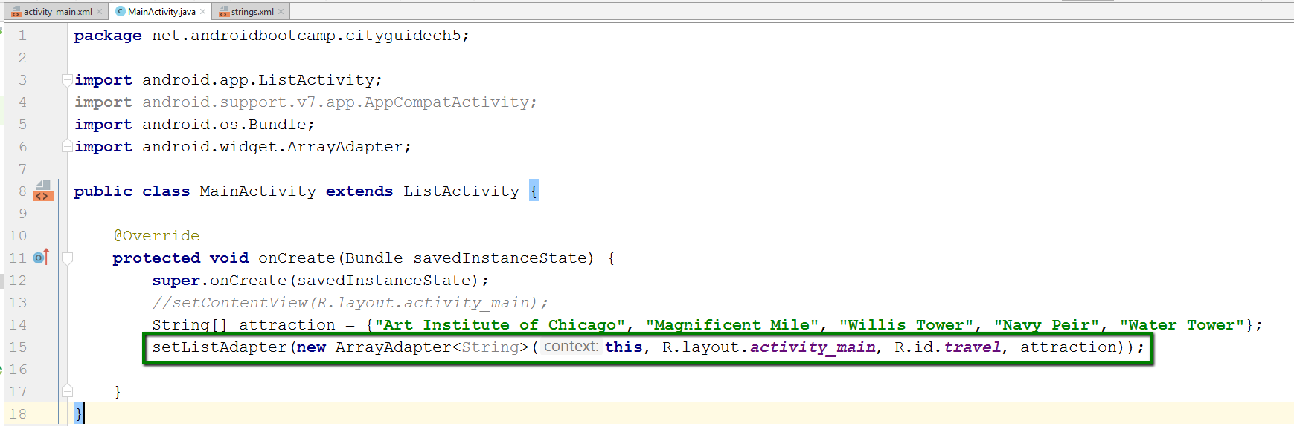
Change Java code for setListAdapter
Leave this and attraction as they are
Change second entry to: R.layout.activity_main, R.id.travel

Slide 11
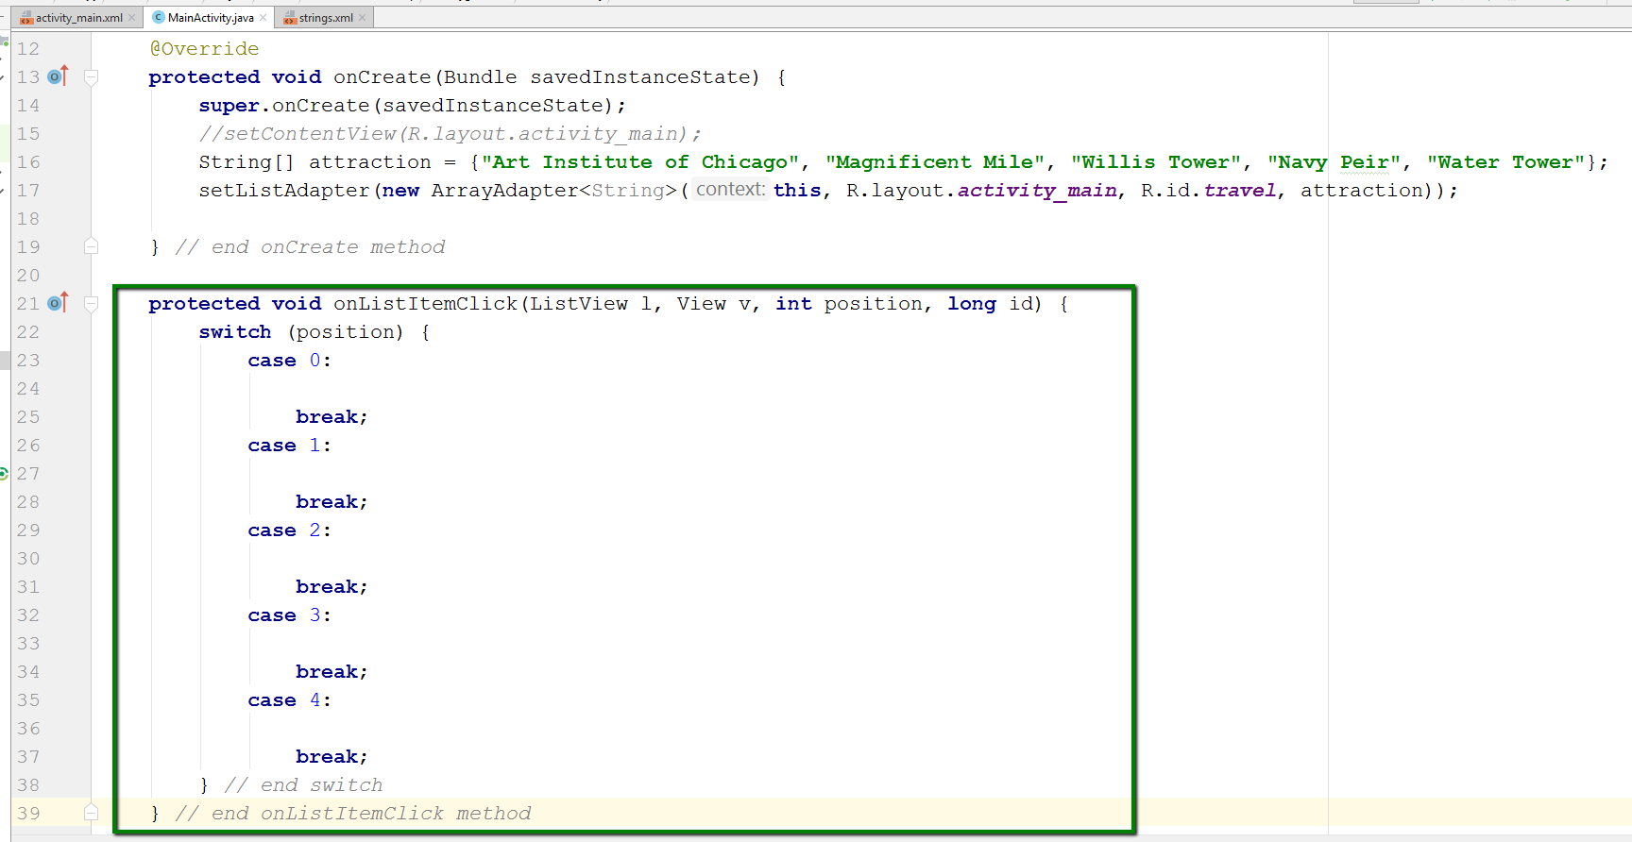
Add onListItemClick method in Java code
This code contains a switch statement
Similar to if-else statement, but only works with specific values, rather than ranges of values
Each value gets a case statement.
Within each case, a break statement exits the switch completely after processing is done.

Slide 12
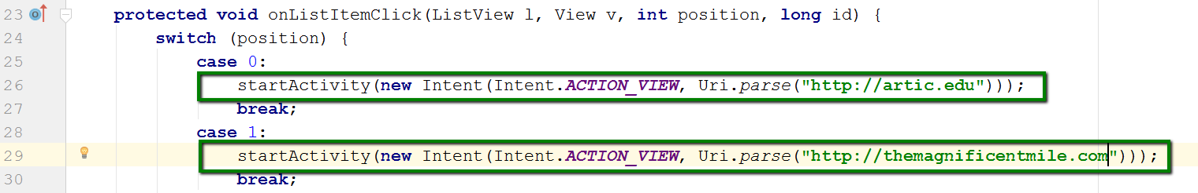
Add activities to first two case statements
Intent – Used in Android to launch a web browser
URI (Uniform Resource Indicator)
It’s like a URL with added info for getting access to resources needed to post the web page.
ACTION_VIEW – generic action to send any request to get most reasonable action to occur

Slide 13
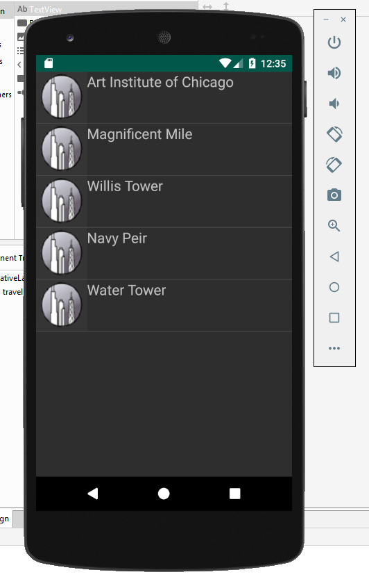
Run the app. You should get this:

Slide 14
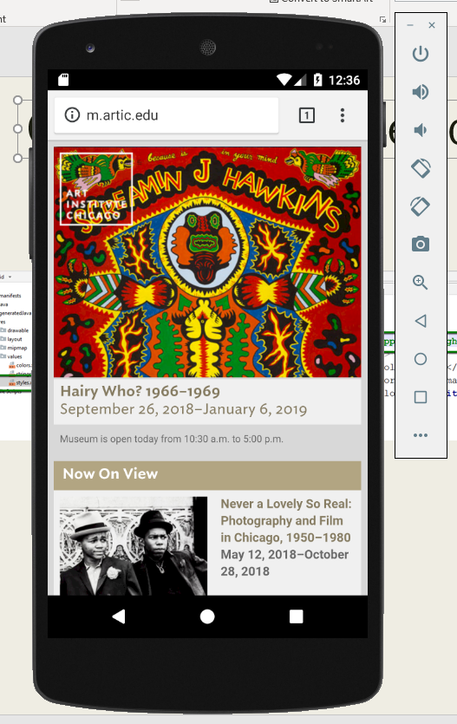
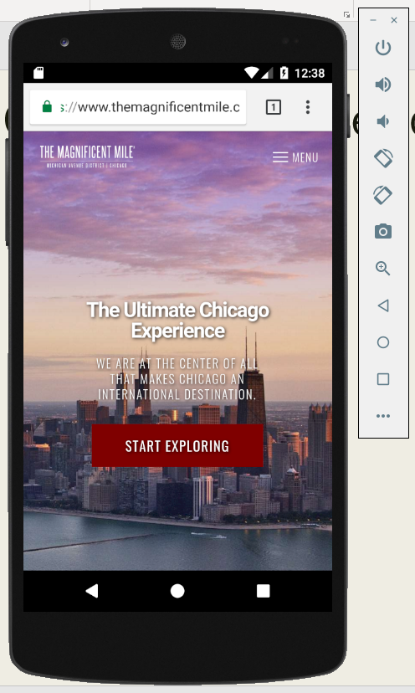
Click on first two selections to get these:

Slide 15
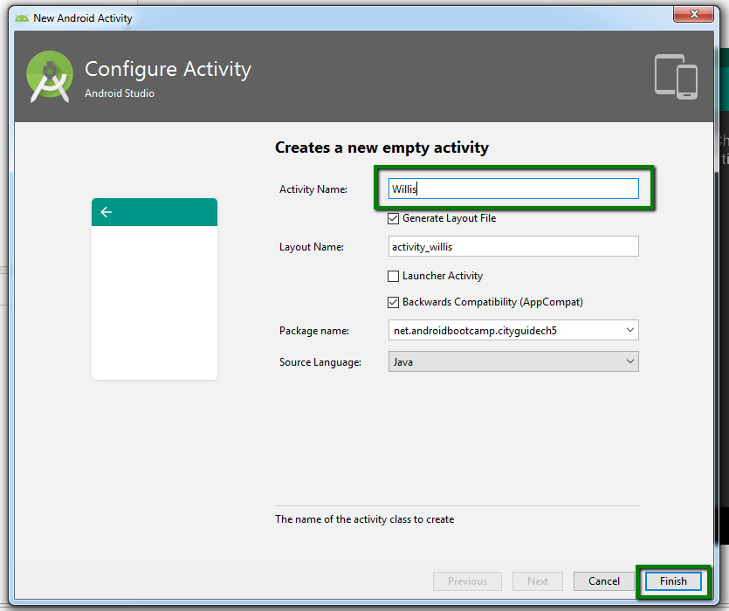
Add new classes for other three selections
In Project Viewer, right click on first net.androidbootcamp.cityguide folder under java folder.
Follow this sequence in the menus:
New->Activity->Empty Activity
In Configure Activity window, type Willis for the Activity Name and click Finish
Close the willis.java file.
Repeat for Pier and Water

Slide 16
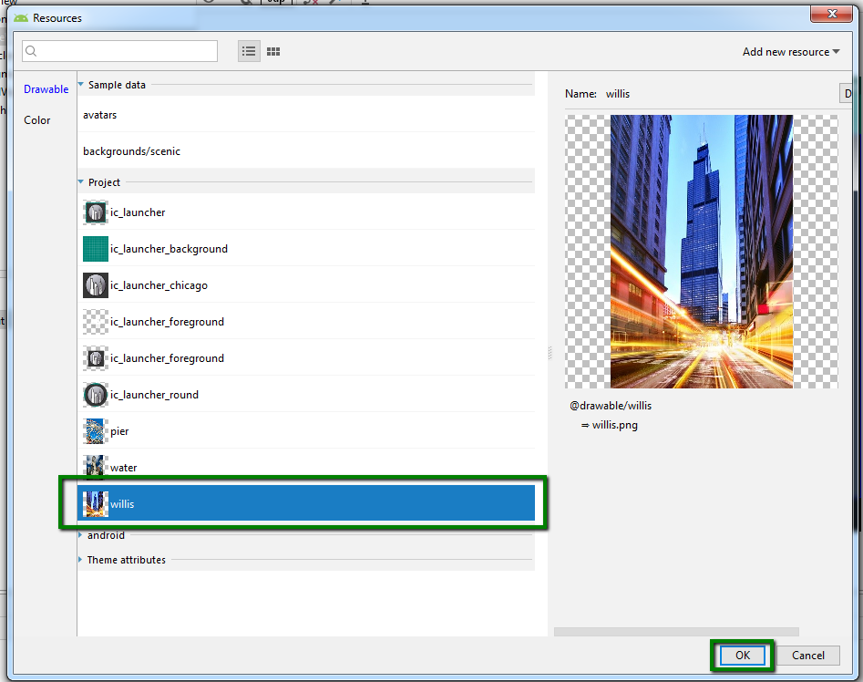
Add ImageView widget and image to new activities
Drag and drop ImageView widget onto Willis screen
In Resources window (which should appear automatically), select the willis image and click OK.
If using Constrained Layout, click “magic wand” button to set constraints
Change ID attribute to imgWillis
Change contentDescription attribute to @string/willis
Repeat for Pier and Water

Slide 17
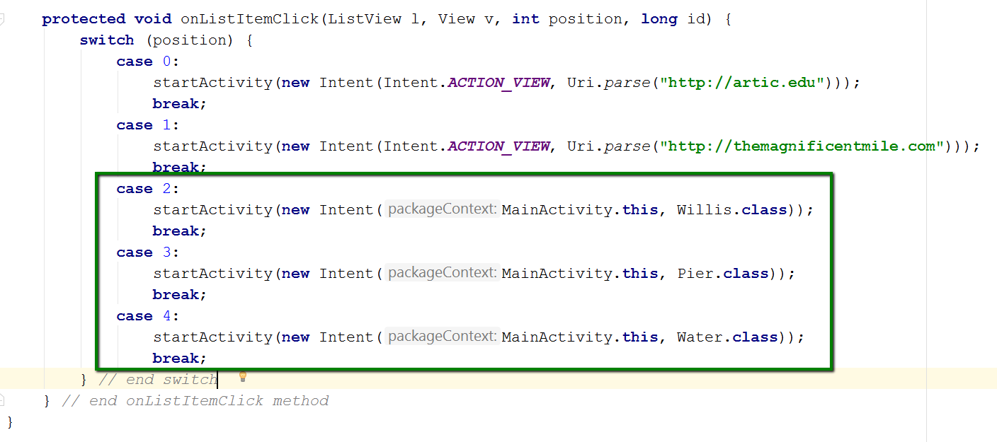
Add code for other switch values
Add the code in the green box to the onListItemClick method as shown:

Slide 18
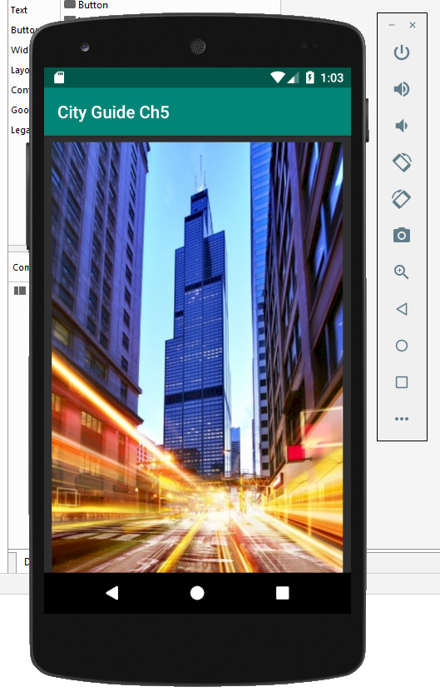
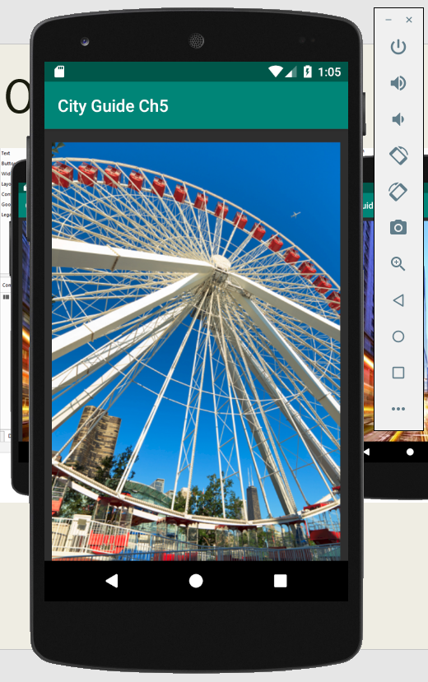
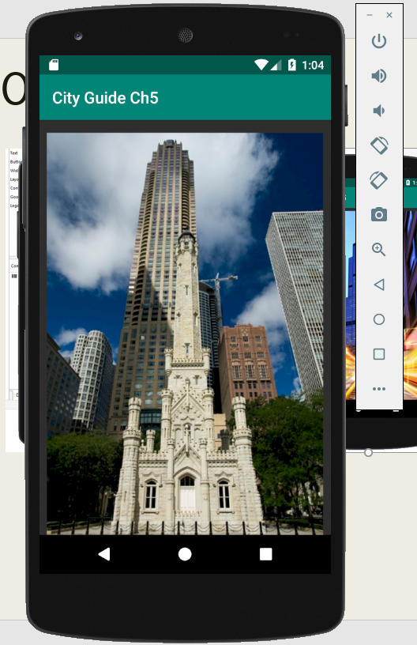
Output Samples

